Slide 1
A report on facilitating Distance Learning
A report on distance learning – Improving access to physiological therapies

Slide 2
Introduction - What is THE IAPT Programme?
The Improving Access to Psychological Therapies (IAPT) programme began in 2008 and has transformed the treatment of adult anxiety disorders and depression in England, and in the past year alone more than one million people accessed IAPT services for help to overcome their depression and anxiety, and better manage their mental health.
In Feb 2018, the NHS published the Five-Year Forward View for Mental Health plan and one of the main objectives of this plan is to expand and develop IAPT services and their workforce.
The aims for the IAPT service development are:
Expanding services so that 1.5m adults can access care each year by 2020/21. Plans to expand this further so that 1.9m adults can access care each year by 2024.
Supporting people to find or stay in work. Good work contributes to good mental health, and IAPT services can better contribute to improved employment outcomes.
Improving quality and people’s experience of services. Improving the numbers of people who recover, reducing geographic variation between services.
Focusing on people with long term conditions.

Slide 3
John Moore's IAPT DISTANCE LEARNING COURSE’s
Due to the expansion of the IAPT workforce, trainee Employment Advisors across the country have enrolled on EA and SEA courses to improve their skills and knowledge.
I have been assisting the in delivery of two Distance Learning courses that John Moore's facilitates, these are:
EA Course – This is a bespoke course specifically designed for Employment advisors working within an IAPT setting. It assists in the training of EA's to provide intensive, personalised support to people who are receiving help from mental health services and are unemployed and who wish to find or return to work.
SEA Course – Similar to the EA course, this is a bespoke module which has been designed specifically for Senior Employment Advisors working within an IAPT structure who has supervisor/leadership responsibilities. This course focused on supervision, leadership & management and the theories and concepts that underpin these approaches in practice.
Employment Advisor Course | Senior Employment Advisor Course
4000-IAPT-201819-SEM-1 | 4001-IAPT-201819-SEM-1
4000-IAPT-201819-SUM | 4001-IAPT-201819-SUM
4000-IAPT-201920-SEM1 | 4001-IAPT-201920-SEM1
Notes:
Research assistance & Learning Technolonist

Slide 4
Course Delivery
Many of the EA and SEA's are already working in an IAPT setting and dedicate one day a week to complete a "Study Day" which contains all the learning materials for that week's session. There is 15 Study Day's in total on the EA course and after the 15 weeks have ended. They will complete a Scenario Based Role Play which they will be assessed on.
A Study Day contains the following:
A recommend Article/Journal to read.
A session delivered online by a lecturer.
A Quiz relating to the session topic.
A Discussion Board Topic.
A Session Evaluation.
Assessments:​
Formative – Scenario based role-play. ​A range of scenario-based role-plays are undertaken and recorded in service and formatively marked by supervisors. ​
Summative – Scenario based role-play. The assessment will consist of a role-play of between 30 to 45 minutes and will be marked by our course tutors.

Slide 5
Dedicated Student Support
Throughout the IAPT course's, I've provided technical support to hundreds of distance learning students.
I've provided this support through a few different channels like a dedicated phone line, over email and in the course chat within canvas.
I've carefully thought about processes the students may need to go through to upload their assessment submissions. I've also thought about the processes the students need to go through to access resources.
From this, I've created numerous pieces of guidance for the students so they can confidently navigate through the course, access the course resources confidently, and uploading their scenario-based role play submission successfully.
I often found that if more than one students was experiencing the same problem with the course, then chances are that all students would be affected by the problem at hand. So it's important to try to quickly resolve issues.

Slide 6
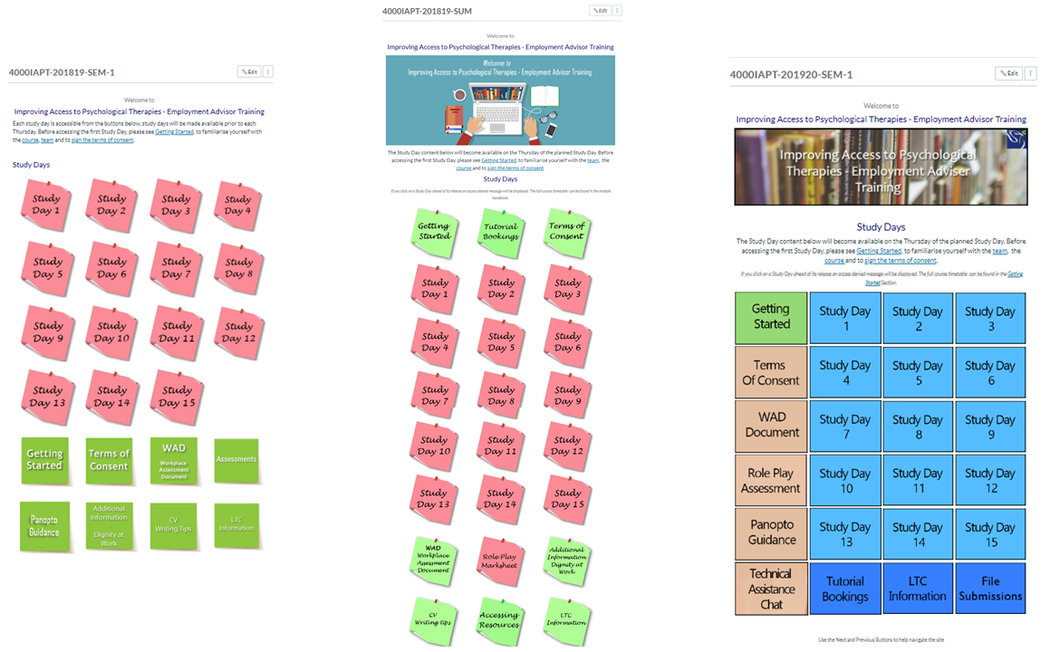
Course design
https://canvas.ljmu.ac.uk/courses/41149

Slide 7
What makes it possible?
I feel that these tools have been vital in facilitating distance learning:
Canvas – Our VLE
Panopto – Our educational video platform.
Office 365 – Cloud based Microsoft Office package
Benefits of using these tools:
Easy Collaboration
Work efficiently
Work from anywhere, anytime, on any device.

Slide 8
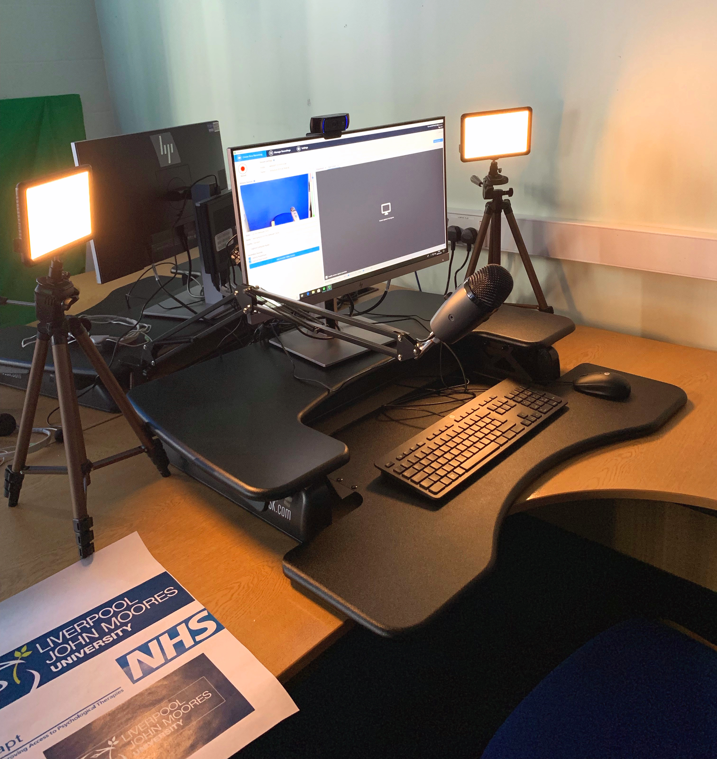
LESSIONS LEARNT
Below are some of the most important things I've learnt whilst administrating the IAPT distance learning courses:
High quality video and audio recordings is a necessity for distance learning. (1080p or 4k).
Make use of the Chat facility on Canvas, it adds a human element to the course.
A clear coherent course design is vital, clear signposting and navigation throughout the module. Step by Step instructions so it's suitable for students
Make sure that any guidance you give to the students is easy to follow whilst comprehensive.
Give your students plenty of opportunities to engage with their peers.
Use challenging quiz questions to get students thinking and independently researching the session topic. Promotes independent learning which distance learning is all about.
Make tasks a required, don’t allow tasks to be optional. Leaving tasks set by the tutor's as optional means less students will engage with the resource.

Slide 9
Future Recommendation's for facilitating distance learning
Below are some of my future recommendations for distance learning courses:
I recommend that prerequisites be utilized for important tasks, for example signing a consent declaration. This means that some of the content may be locked until they complete the prerequisites condition. This is a good way to guide the students to complete a certain task on the course.
There is an opportunity to use individual learning path's for distance learners by used Canvas' Mastery Paths. E.G < 70% redo and provide a support resource. If students get < 40% in a quiz, the tutor may want to speak to the students and assist their learning.
Accessibility integration – Ensure that all the course videos have subtitles, ensure that all course pages meet guidelines set by GCAG. Loads of useful tools online to assist you with this!
Make more peer to peer engagement requirements - Spark as much peer to peer engagement as you can – This was a huge success for us on the IAPT course as many EA's across England exchanges ideas, opinions and . Creating an online community from simply getting the students to engage with a different discussion topic each week.
Make use of Panopto and Canvas analytics to ensure students are engaging with the course content properly. If anyone is seen "skimming" through the course, notify them and encourage again.
Preparation is vital, Course multimedia, content, assignments, discussion topics can all be set up before the course even begins. Disorganization leads to mistakes and mistakes on the course can lead to a negative student experience.
Design the course layout before creating it, try to make the course as easy to navigate as possible.

Slide 10
Thanks for listening
Niall McCann
Learning Technology Officer
Faculty of Health
N.McCann@ljmu.ac.uk
Alex Seddon
Research Assistant/Psychology Lecturer
Faculty of Health
A.L.Seddon@ljmu.ac.uk
Nick Moroney
Administration Officer
Faculty of Health
N.I.Moroney@ljmu.ac.uk

